Slide 1
Custom BootCamp Week-1
Shivam Jindal

Slide 2
Data Fundamentals
Introduction to DBMS
Basics of DBMS
Need and Uses of ER Modelling
Dimensional Modelling
Star Schema
Snowflake Schema
De-Normalization

Slide 3
Database is a collection of inter-related data which is used to retrieve, insert and delete the data efficiently.
Types of DBMS:
Relational
NoSQL
Object-Oriented
In-memory
Advantages of Using DBMS:
Data Integrity
Data Security
Data Abstraction
Data Independence
ER diagram, is essential for modeling the data stored in a database.
ER diagrams specify what data we will store: the entities and their attributes.
ER Diagram provides easy-to-read documentation of the information being stored and how it is related.

Slide 4
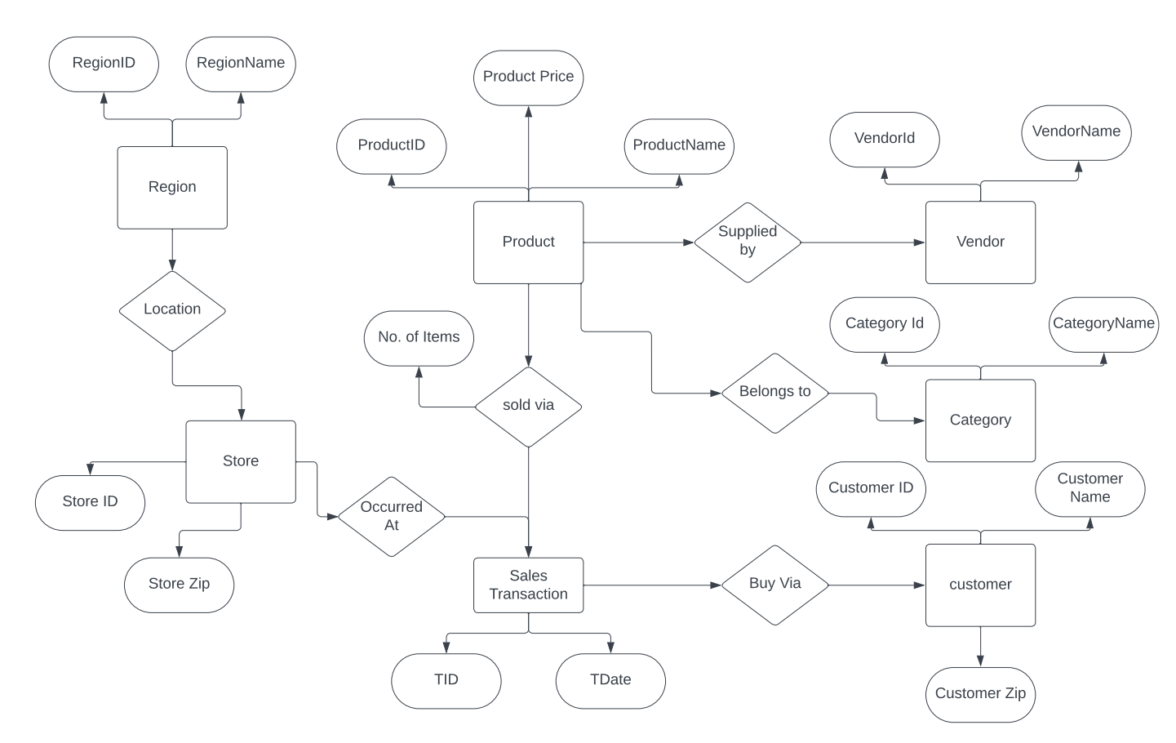
ER Diagram

Slide 5
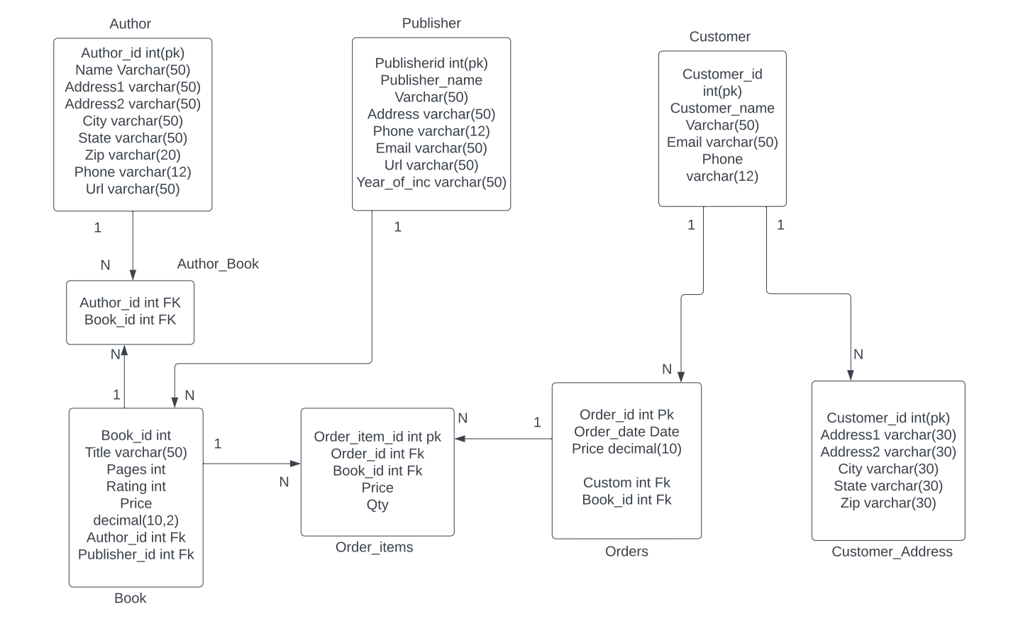

Slide 6
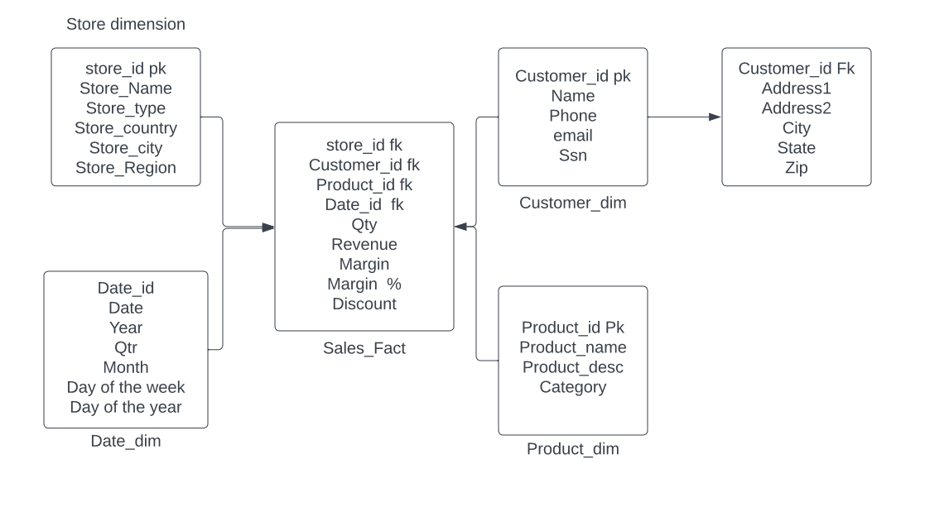
Fact Dimension Table

Slide 7
Dimensional Modelling
Star Schema
Snowflake Schema
The fact tables and the dimension tables are contained.
Top-Down Model
Uses More Space
Take less time for the execution of the queries.
The fact tables, dimension tables as well as sub dimension tables are contained.
Bottom-Up Model
Uses Less Space
Takes more time than Star Schema for execution of queries.

Slide 8
Understanding Big Data Theory
Big Data is extremely large and complex datasets that cannot be easily managed using traditional data processing tools.
Characterized by three Vs: Volume, Velocity and Variety.
Challenges in Big Data:
Storage
Processing
Analysis
Privacy and Security
Big Data Technologies:
Hadoop
Spark
NoSQL Databases
Machine Learning

Slide 9
Hadoop: Distributed Data Processing
Hadoop: Open-source framework for processing and storing large datasets across clusters of computers.
Components:
Hadoop Distributed File System
MapReduce
Key Features:
Scalability
Fault Tolerance
Cost Effective
Parallel Processing
Supports Various data Types

Slide 10
Use Cases of Hadoop:
Data Analysis: Extract insights from large datasets.
Log Processing: Analyze logs for trends and anomalies.
Recommendation Systems: Generate personalized recommendations
Genomic research: Analyze DNA sequences for medical research.
Ecosystem:
Hive: Data warehouse infrastructure for querying and managing large datasets.
Pig: High-level scripting language for data analysis.
Hbase: NoSQL database for real-time read/write access to large datasets.
Future Directions:
Integration with Cloud
Advanced Analytics
Enhanced Security

Slide 11
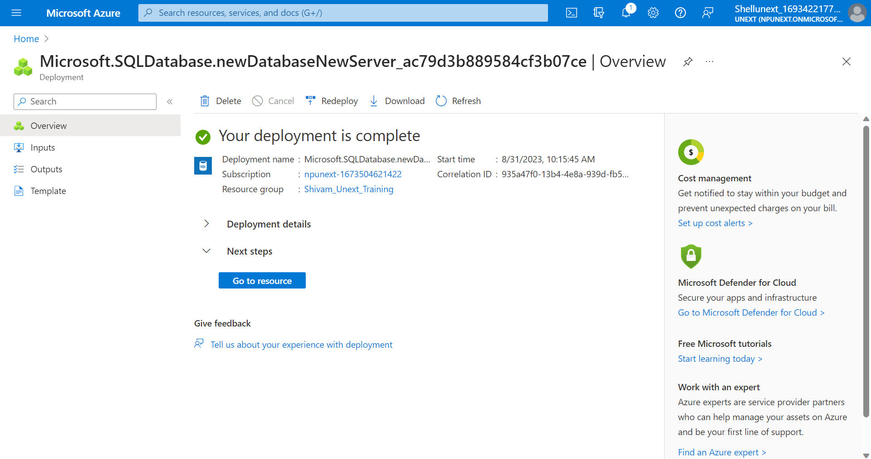
Hands-on Azure SQL Database

Slide 12
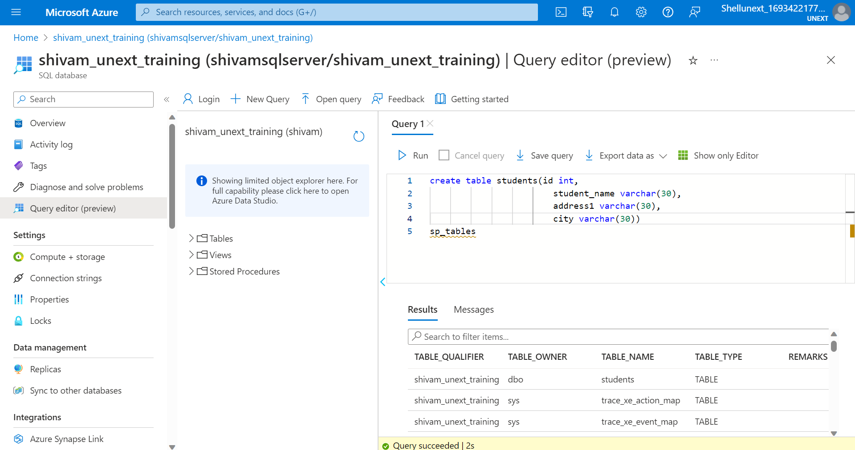
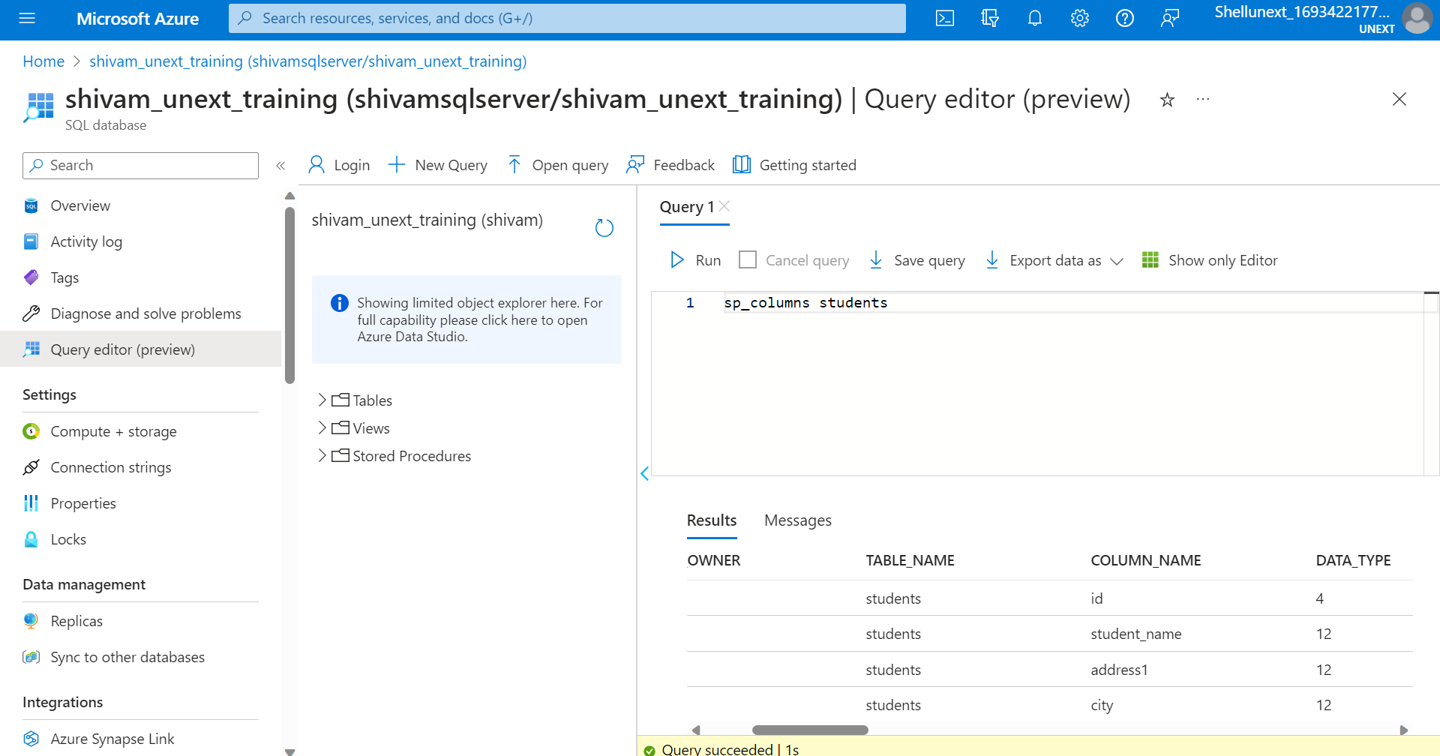
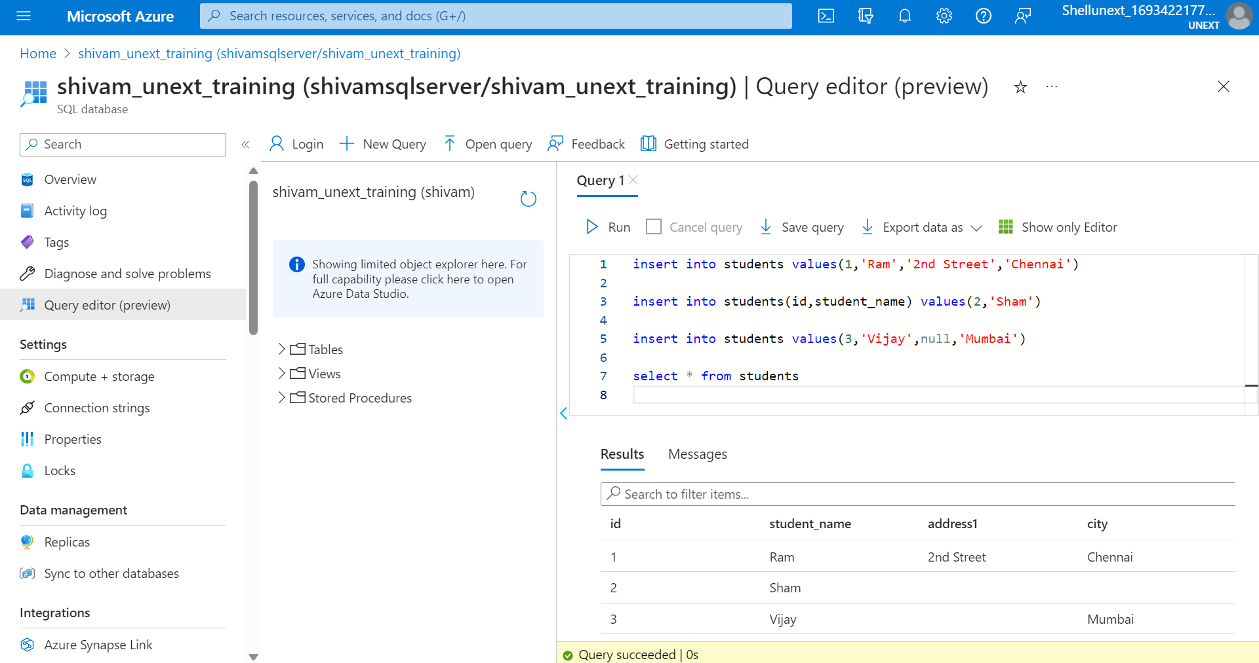
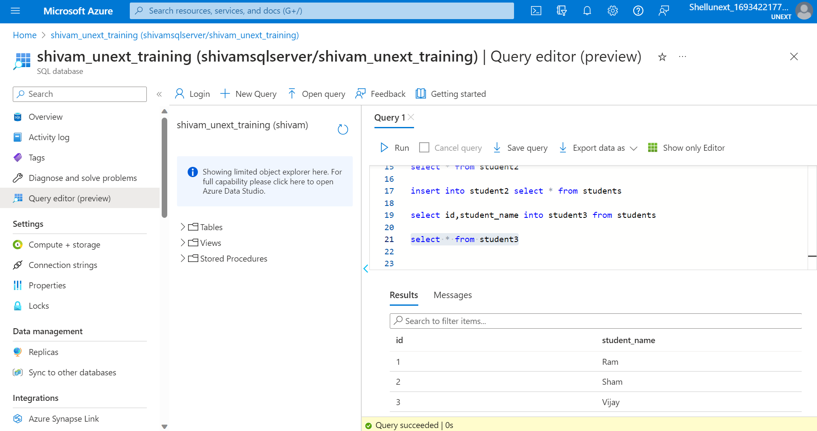

Slide 13

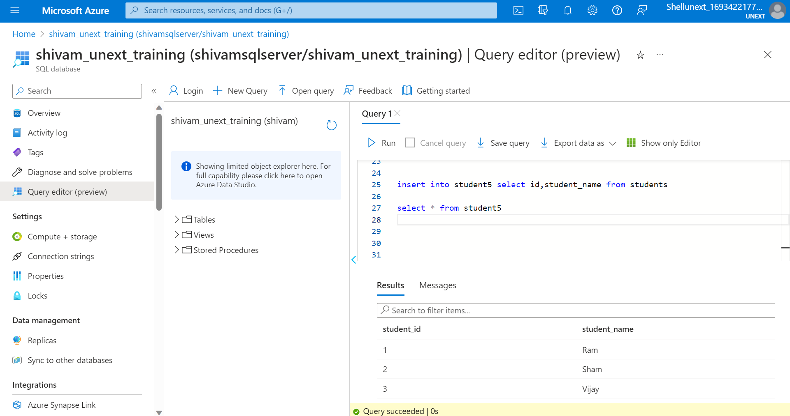
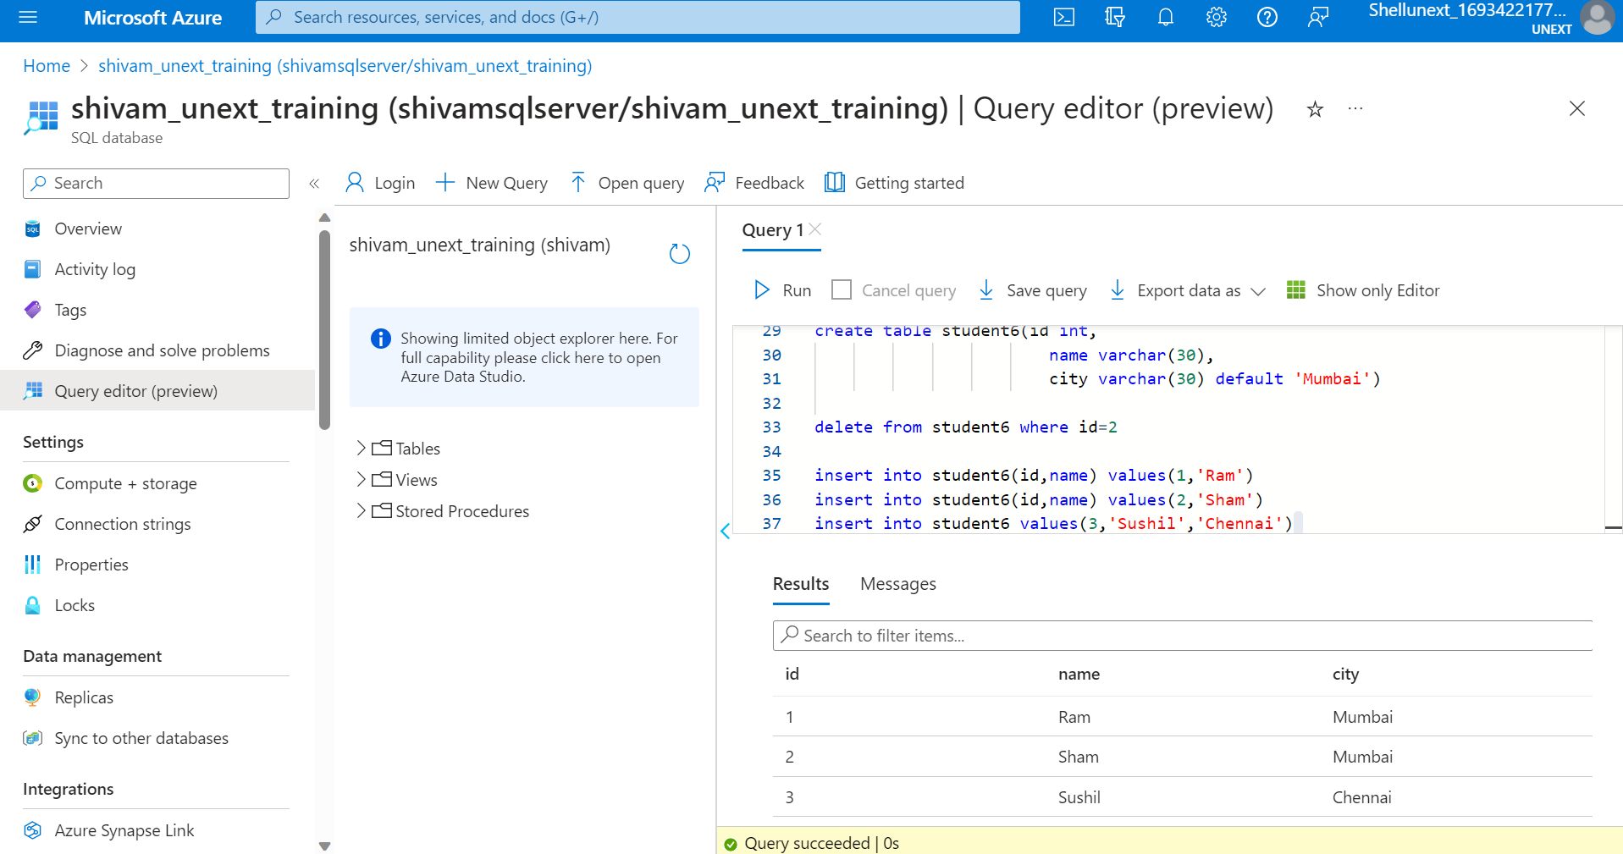


Slide 14
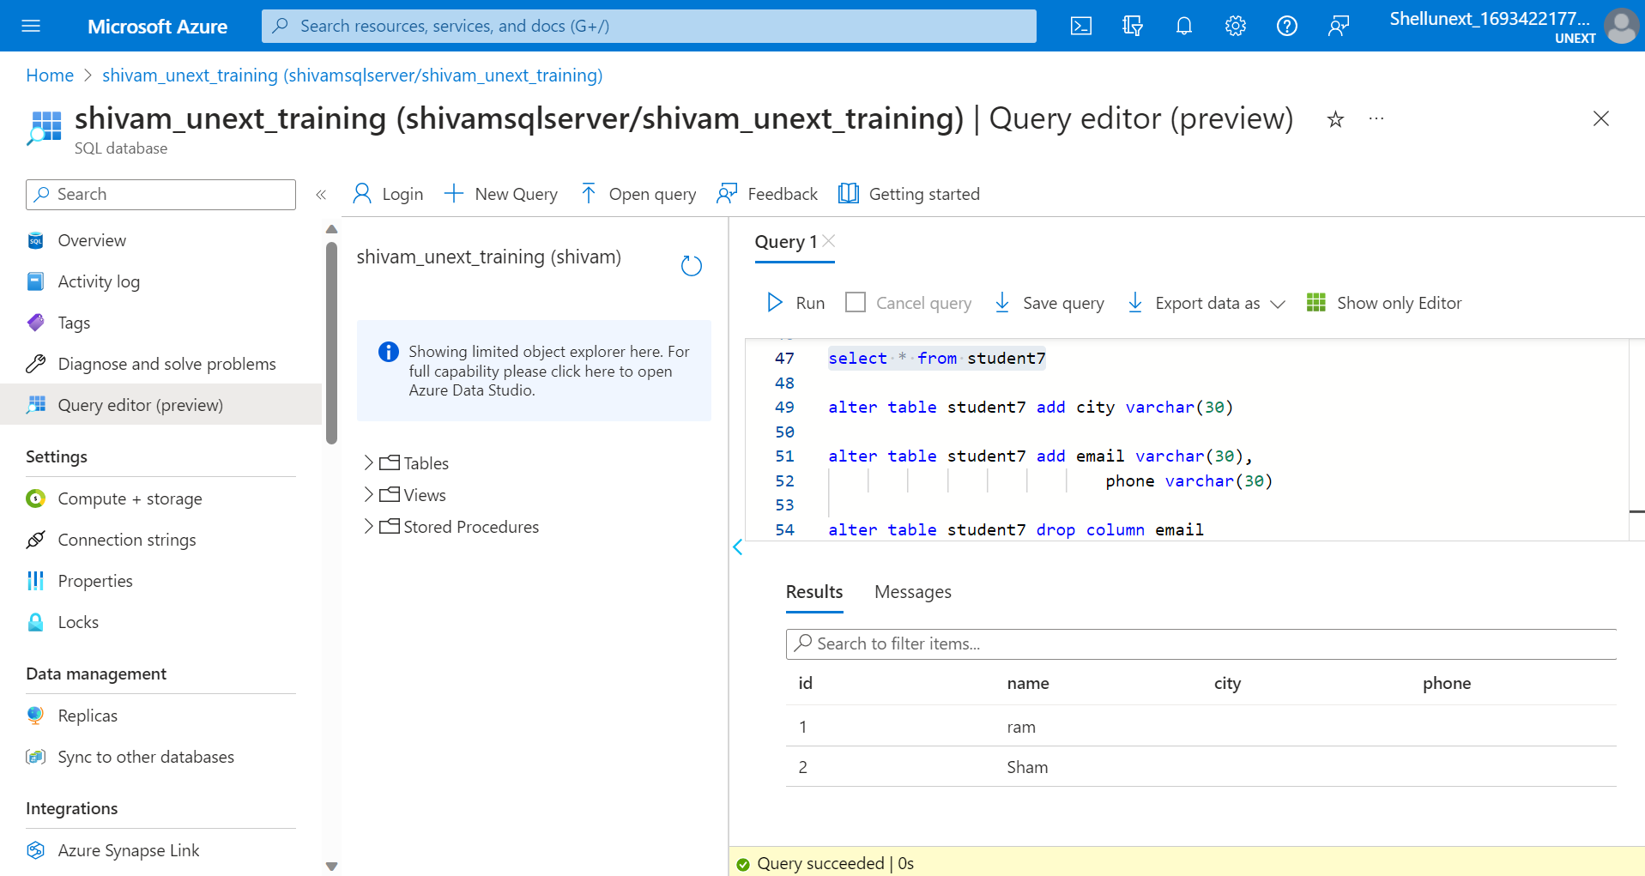
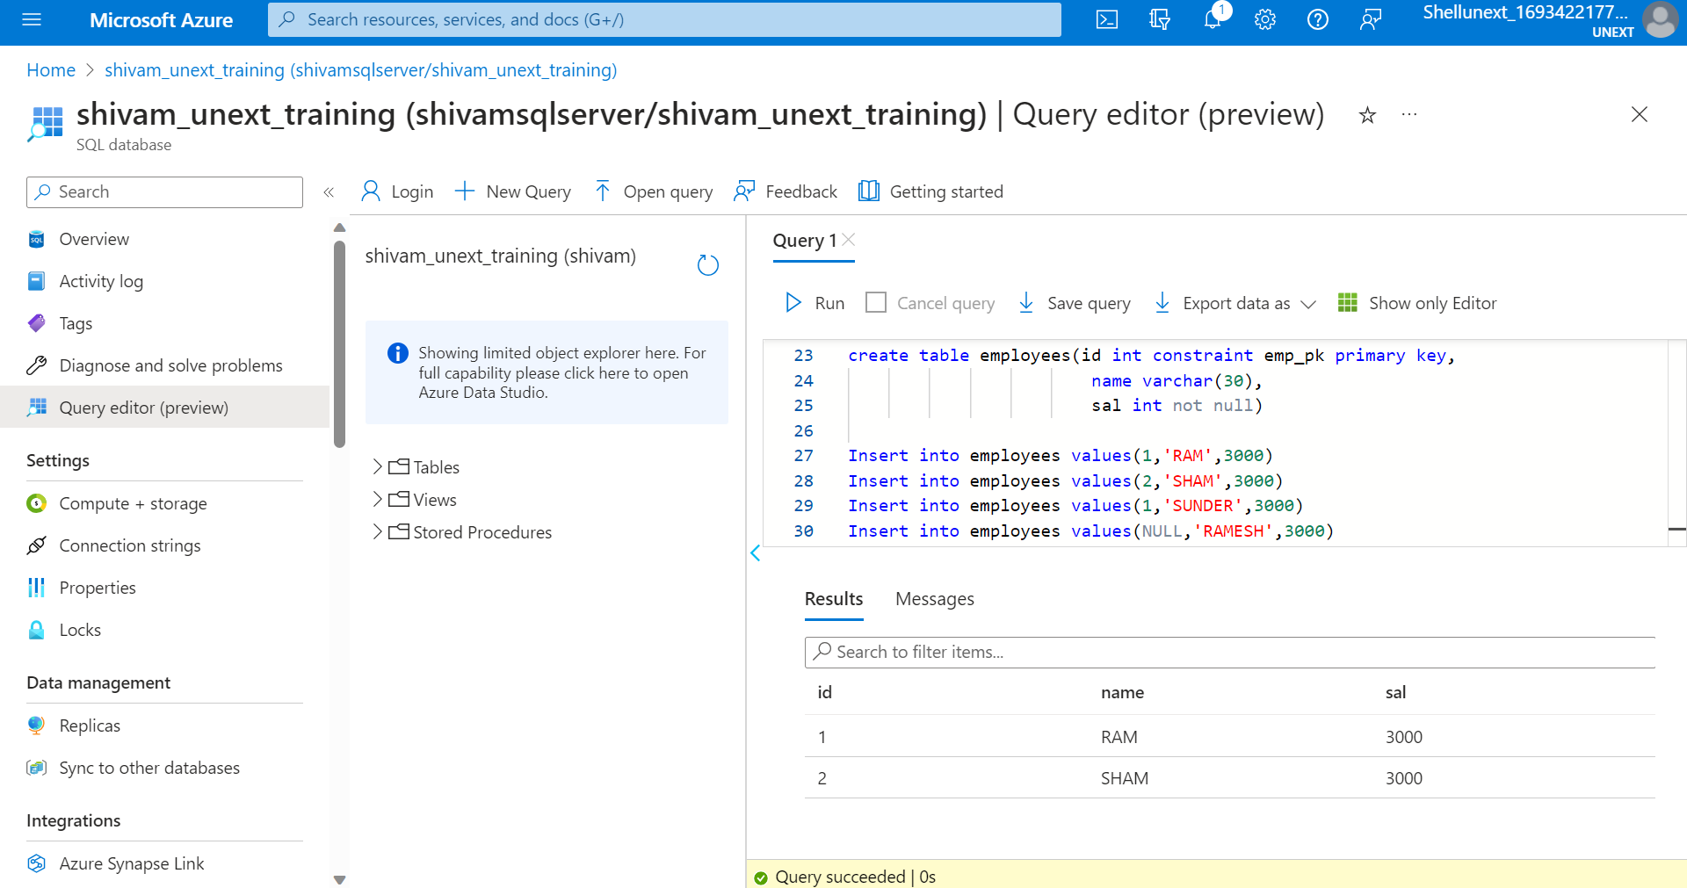

Slide 15
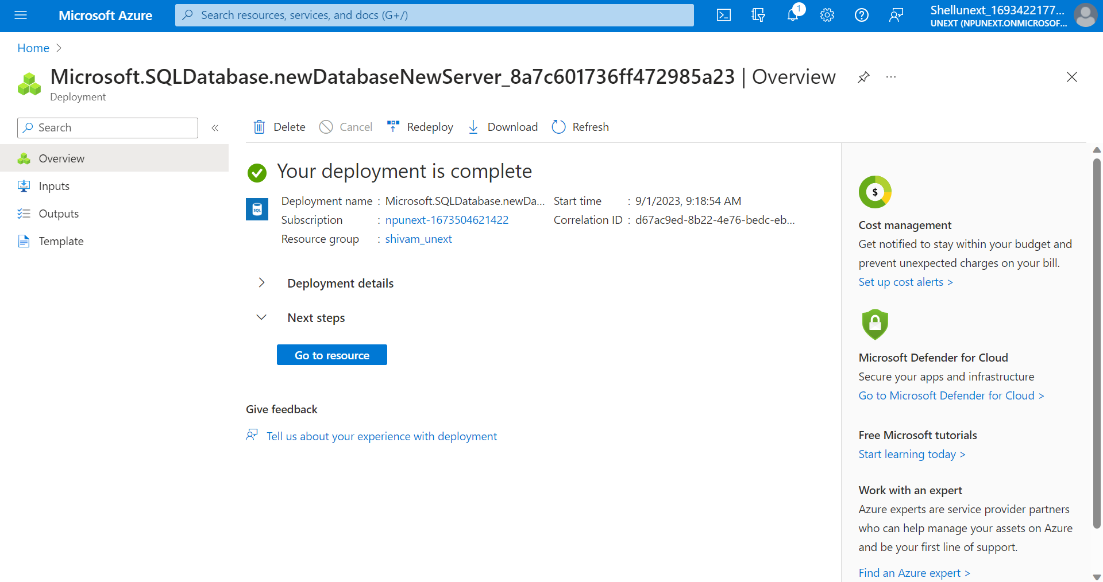
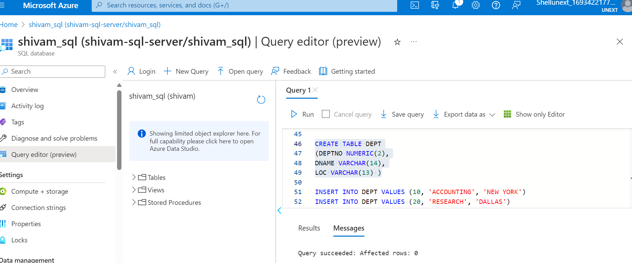
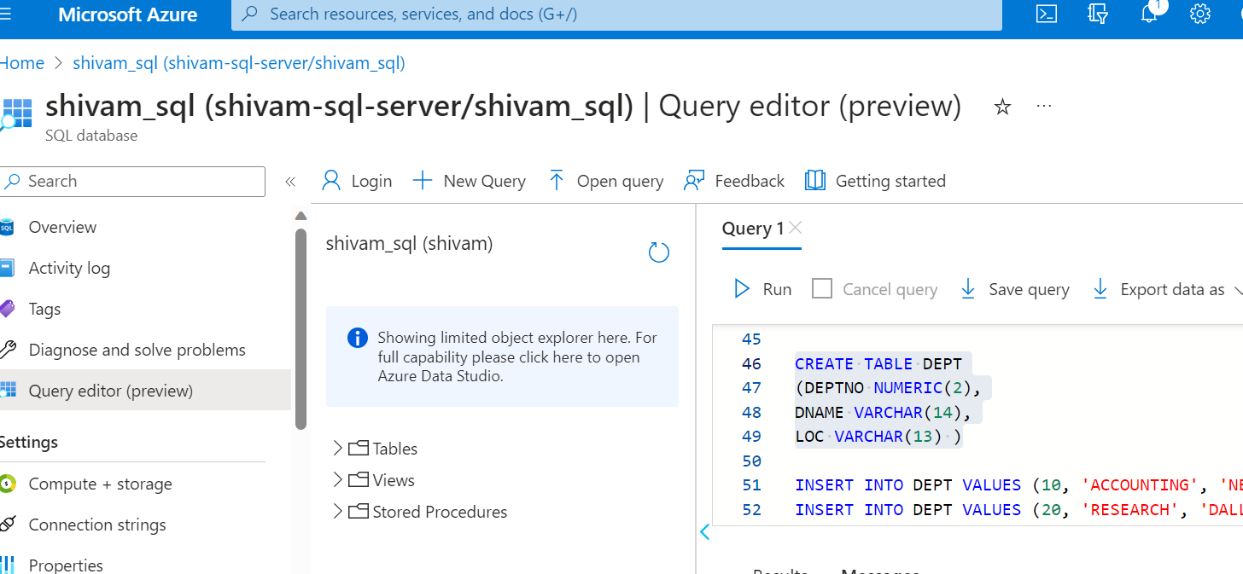
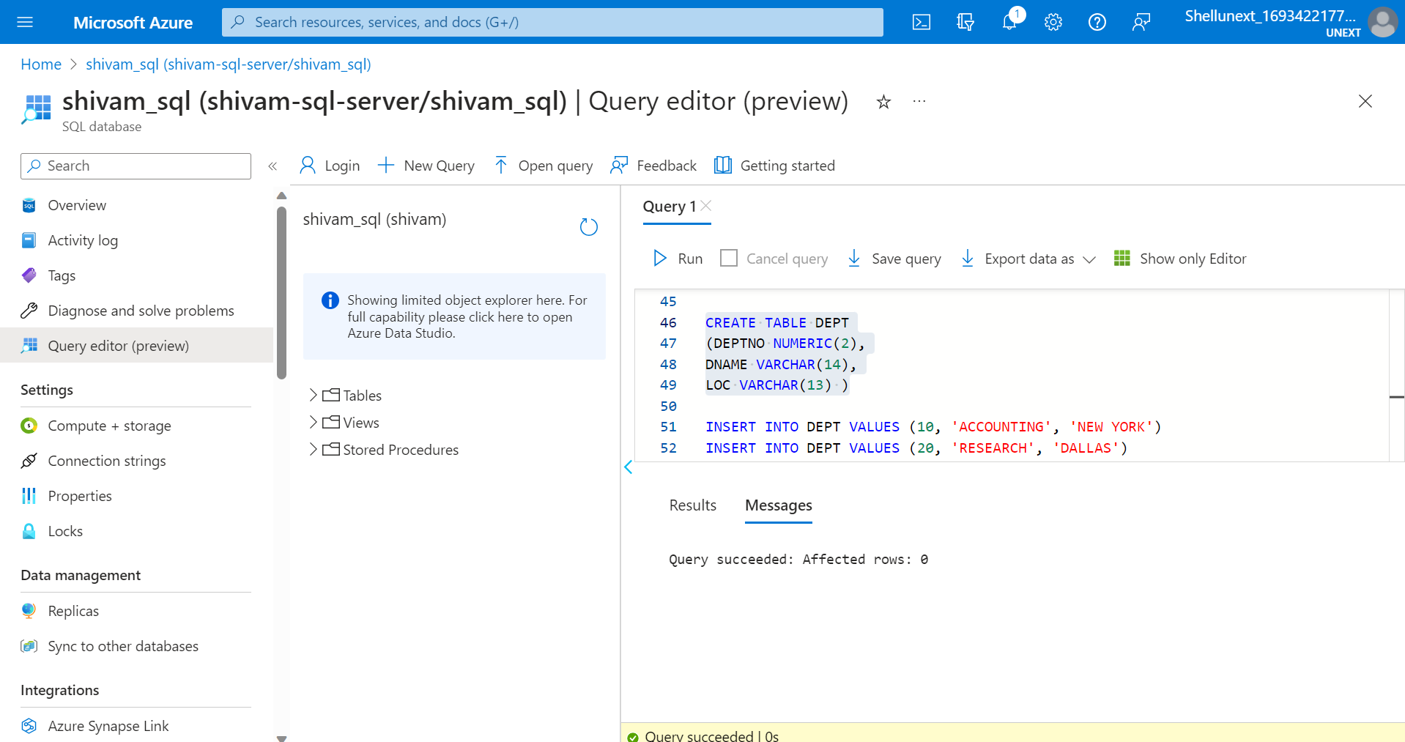

Slide 16
Thank you
Shivam Jindal
Shivam.Jindal@shell.com

